Slide 1

What can we learn?
$I$nternational $C$onference on $M$achine $L$earning

Slide 2













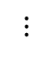
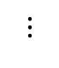
$$⋮$$
$$⋮$$

Slide 3









Relevant Papers:
XRM
 | Optim | OOD
Chain of Code
 | Vison Lang | Analysis
Relevance
Automatic data balance.
Executable using code and LLM.
SamFormer
Optim | Transfor | Timeseries
MagicLens
 | Vison Lang | Analysis
Sharpness-Aware Minimization.
Vision Lang search.
LCA Distance
Classif | Optim | OOD
Expand and cluster
 | deploy | Encryption
Lowest Common Ancestor.
Extract NN weights from black box.
Neuro Visualizer
 |  | Analysis
Homomorphic encryption
 | Transfor | Encryption
Manifold not 2D plane.
Evaluate on encrypted model and data
Test-Time Adaption
Optim | Transfor | deploy
 |  | OOD
Algebraic Structure
 |  | Analysis
TTA without BP.
Math operator in latent space.
Time-Series Forecasting
Optim | OOD | Timeseries
Find learnable part of data.

Slide 4
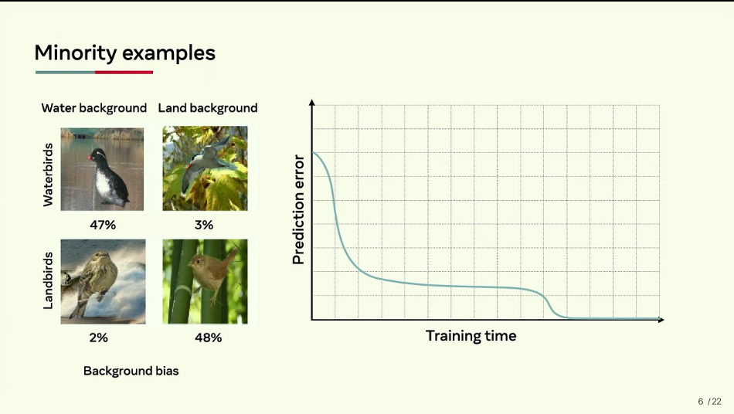
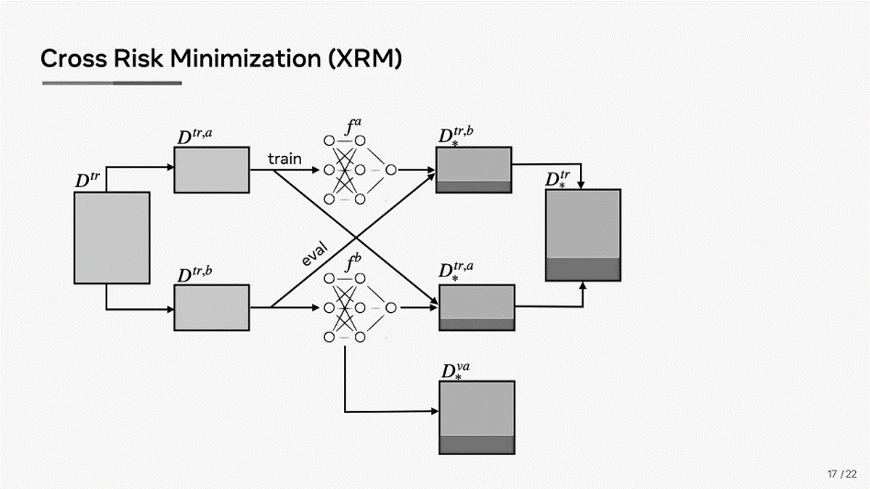
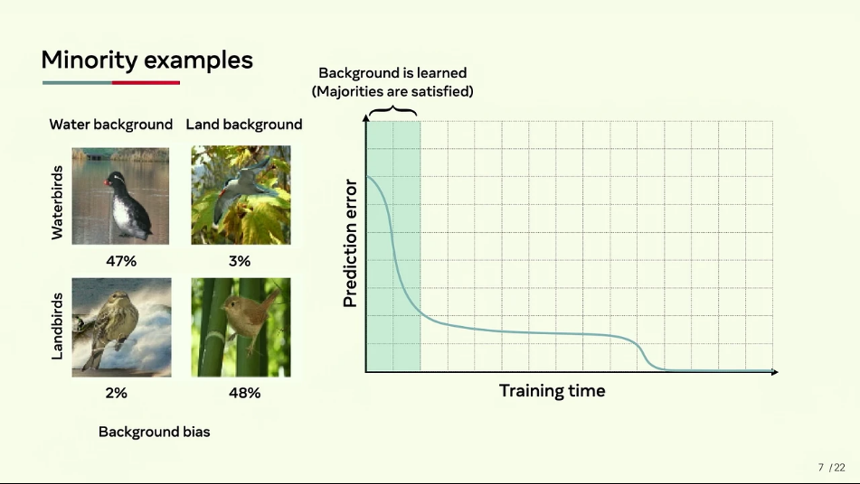
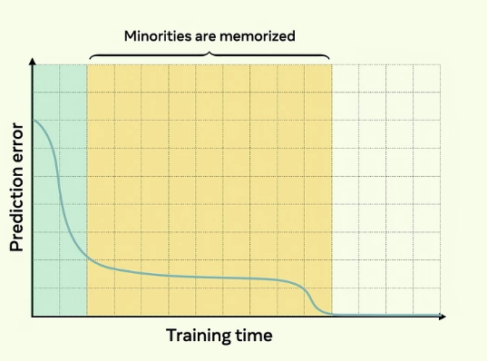
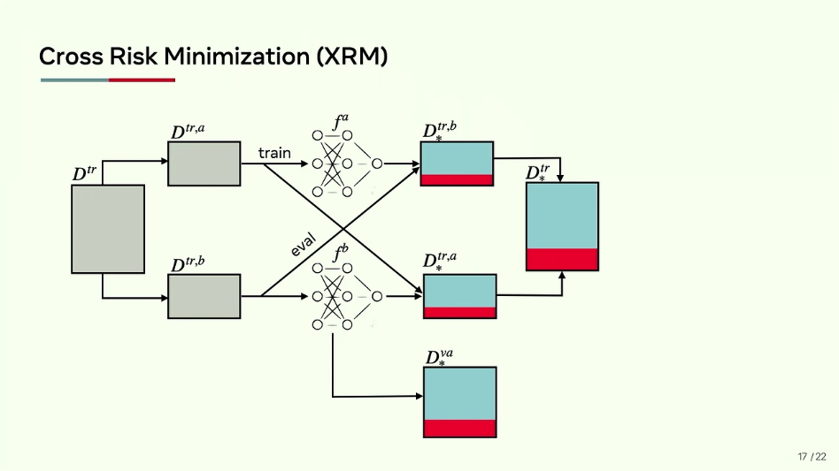
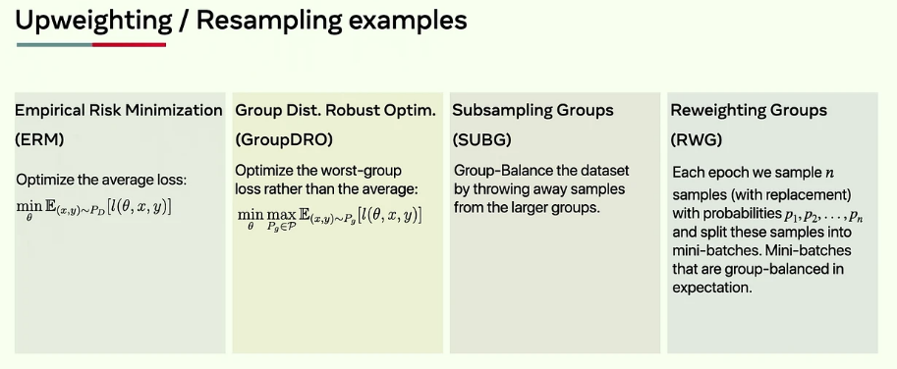
 | Optim | OOD
XRM
Discovering Environments with CROSS-RISK MINIMIZATION (XRM)
Paper
Code
Problem: AI systems struggle when tested in environments different from their training.
Solution: Requires annotations
CROSS-RISK MINIMIZATION (XRM) automatically discover environments within datasets without the need for human annotations!
index:
More:

Slide 5
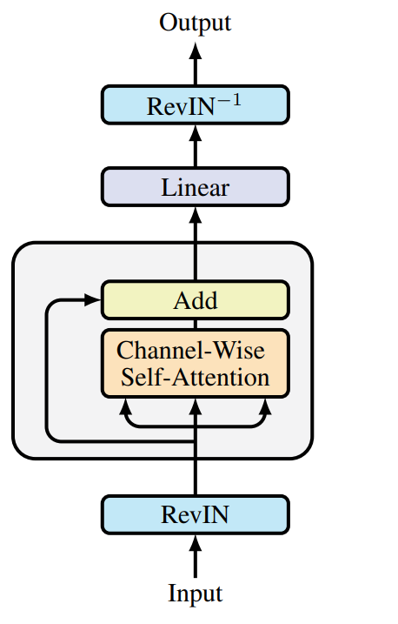
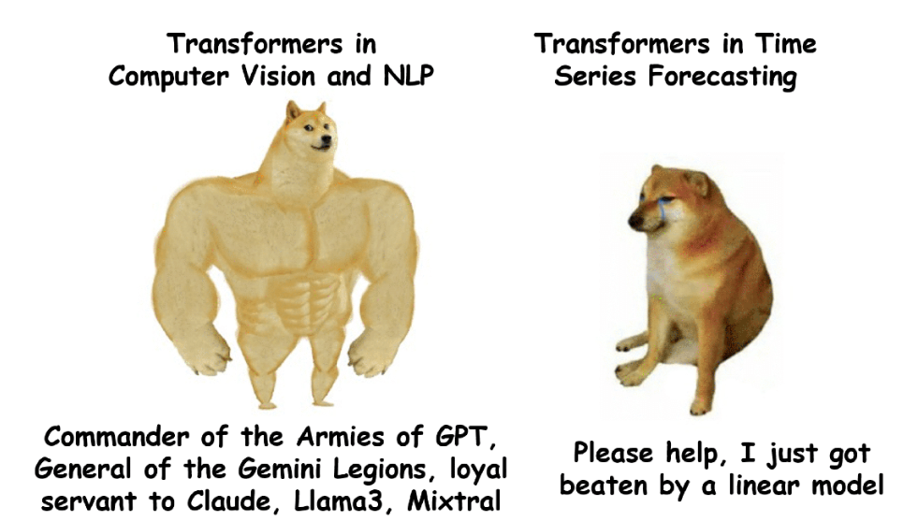
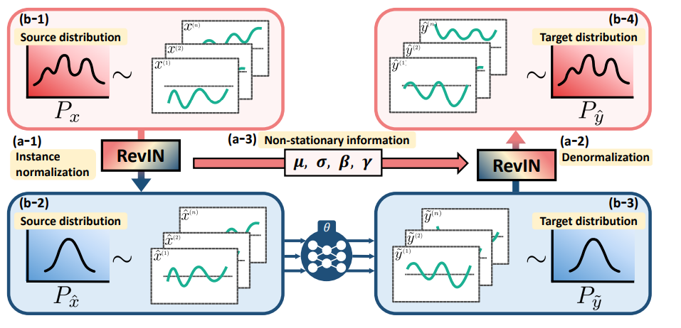
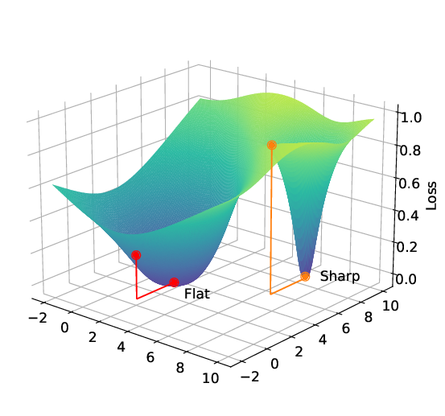

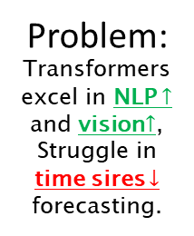
Optim | Transfor | Timeseries
SAMformer
Unlocking the Potential of Transformers in Time Series
[Forecasting with Sharpness-Aware Minimization and Channel-Wise Attention]
Paper
Code
Problem: Transformers excel in NLP $↑$ and vision$↑$, Struggle in time sires $↓$ forecasting.
Finding: Attention has sharp landscape. Solution: Sharpness-Aware Minimization (SAM).
Shallow, lightweight transformer model optimized with Sharpness-Aware Minimization (SAM)
index:
More:

Slide 6
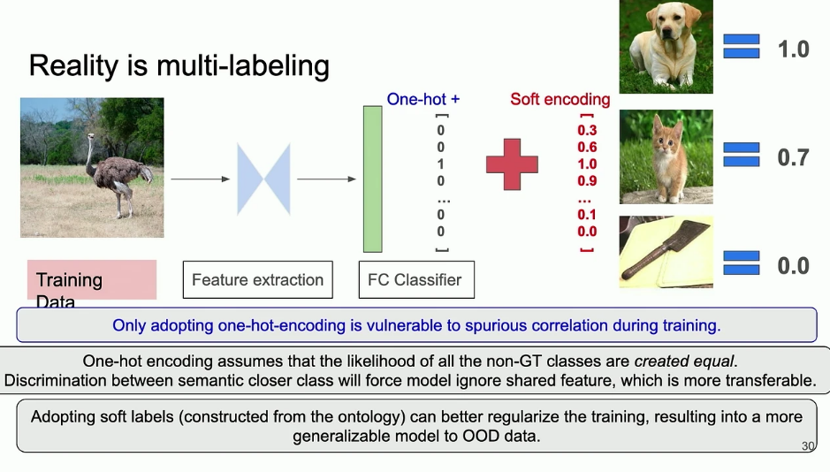
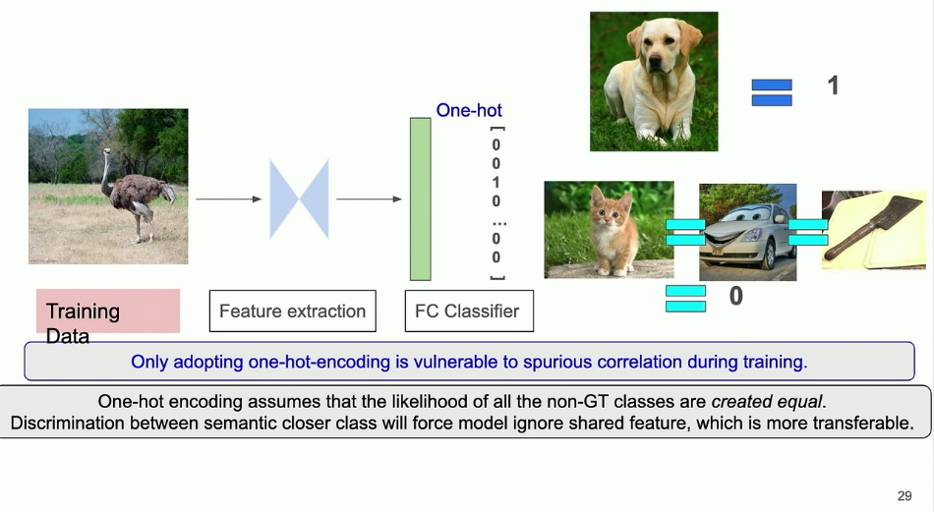
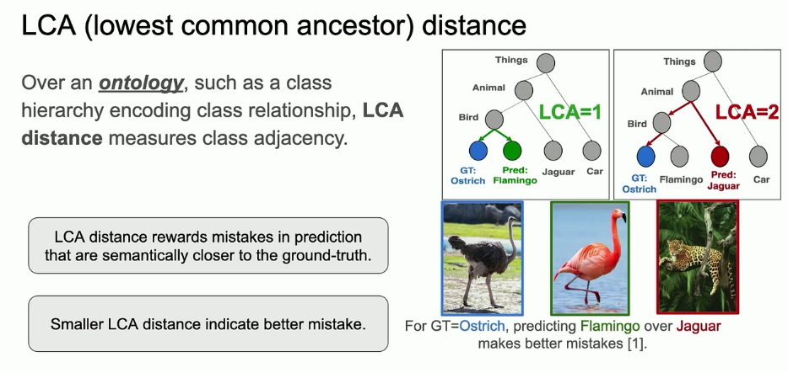
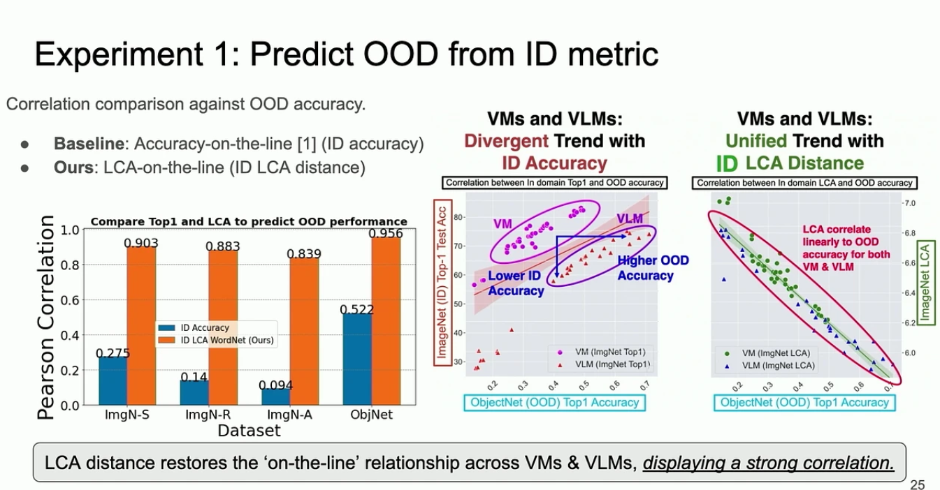
Classif | Optim | ODD
LCA
Benchmarking Out-of-Distribution Generalization with Class Taxonomies
Paper
Code
Enhancing generalization
Problem: Enhancing generalization Predicting OOD performance using ID measurements.
Adopting soft labels can regulate training ->
Generalize better to OOD.
(2) Predicting OOD performance
Solution: Lowest Common Ancestor (LCA)
index:
More:

Slide 7
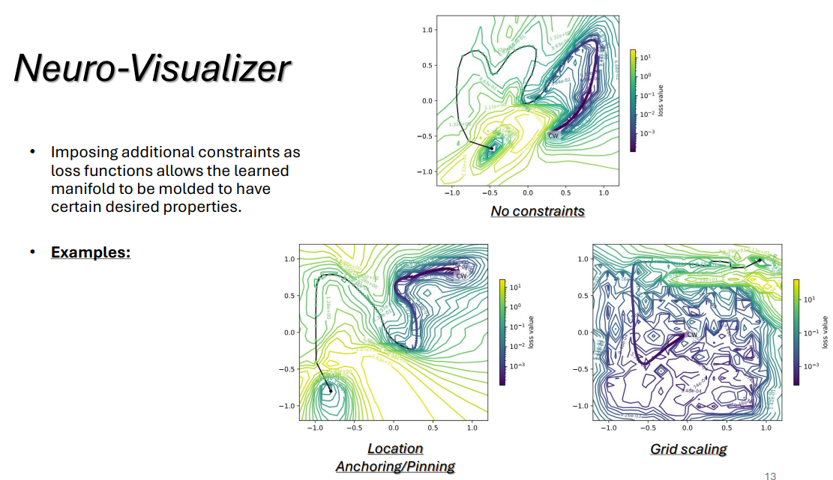
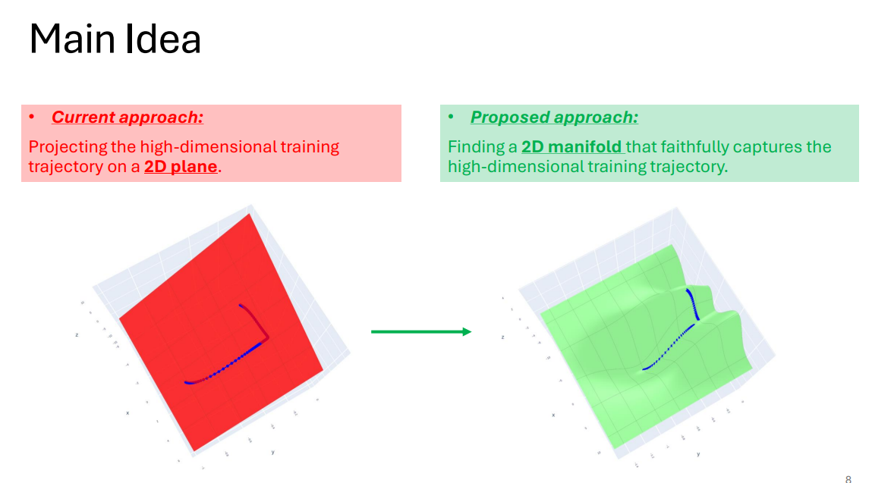
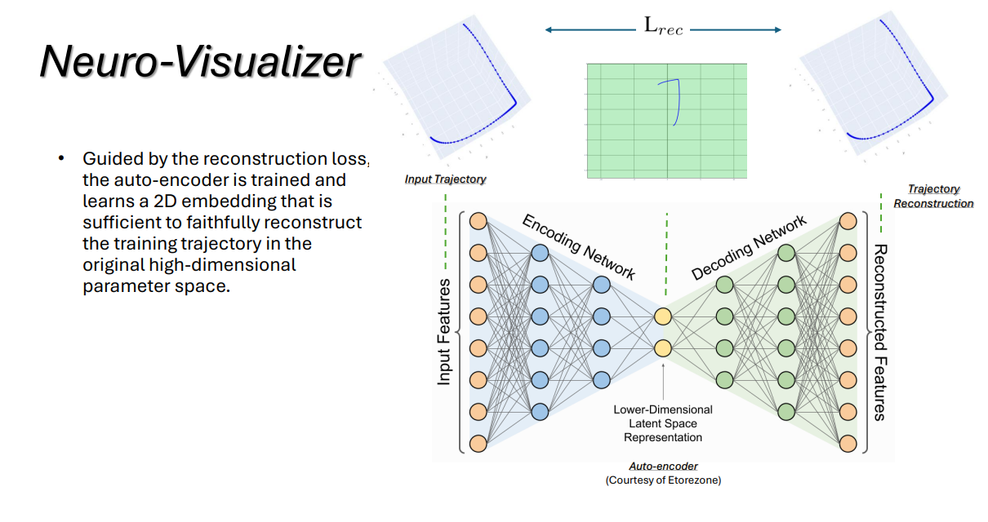
 |  | Analysis
Neuro-Visualizer
A Novel Auto-Encoder-Based Loss Landscape Visualization
[Method With an Application in Knowledge-Guided Machine Learning]
Paper
Code
Trj is not on a 2D plane.
Its on a 2D Manifold!
Problem:
Adding constraints when learning manifold->
Focuses the visualization.
Solution: Learning 2D manifold that contains the Trj, Using Autoencoder.
index:
More:

Slide 8
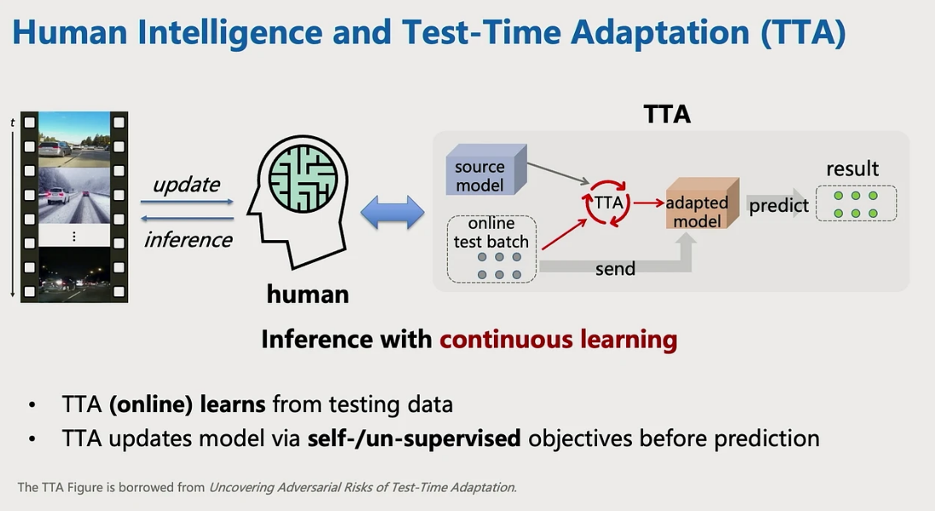
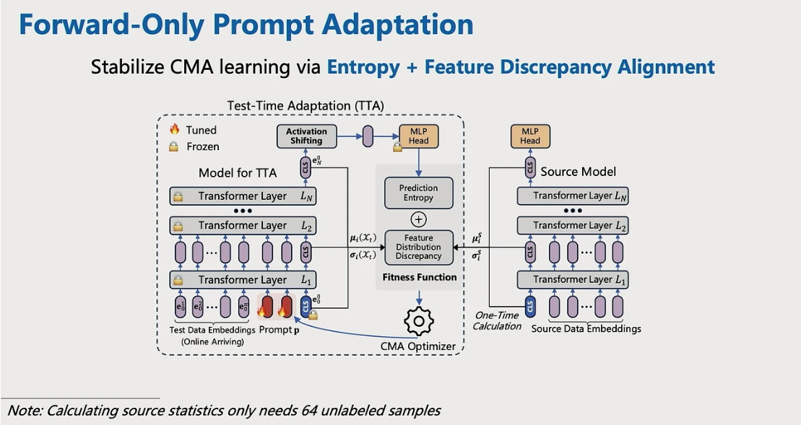
Optim | Transfor | Implement
Test-Time Model Adaptation (TTA)
with Only Forward Passes
Paper
Code
Problem: Current TTA requires BP.
Solution: Forward-Optimization Adaptation (FOA), backpropagation-free method.
index:
More:

Slide 9
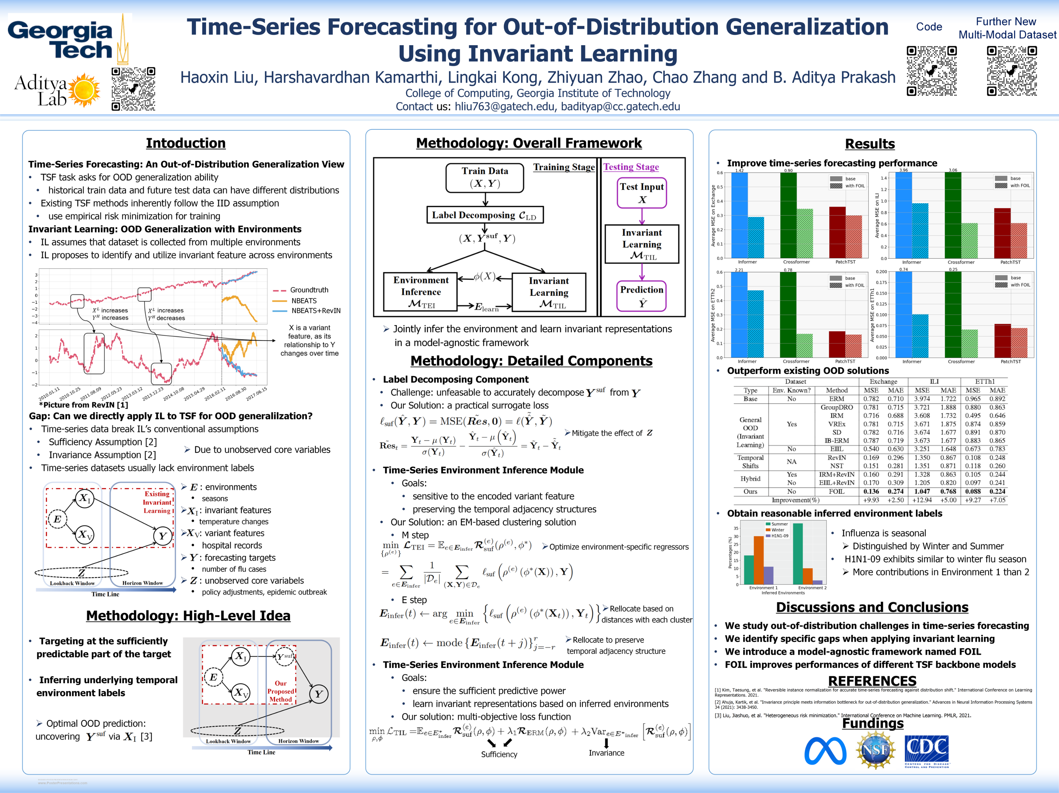
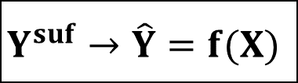
Optim | OOD | Timeseries
Time-Series Forecasting (TSF)
for Out-of-Distribution Generalization Using Invariant Learning
Paper
Code
New method
Old method
Optimize:
Get:
$$Y^{suf}→\hat{Y}=f(X)$$
index:
More:

Slide 10
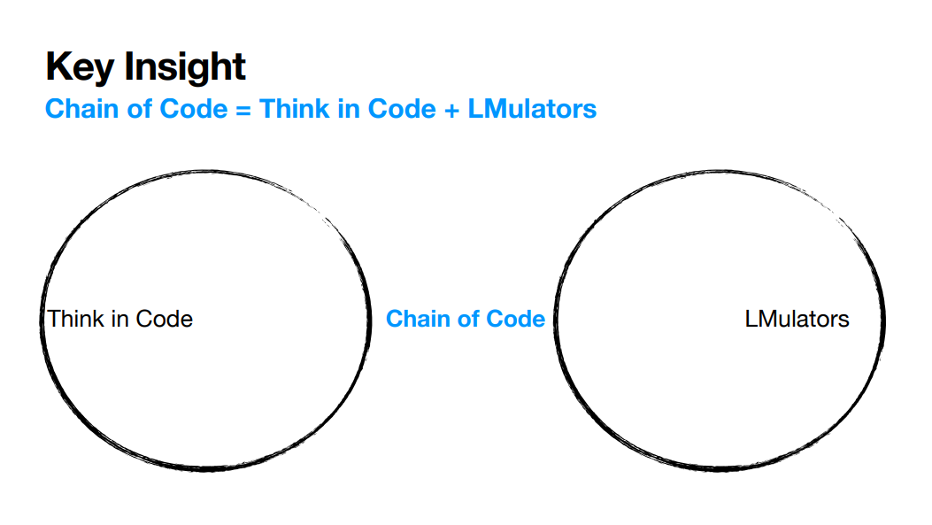
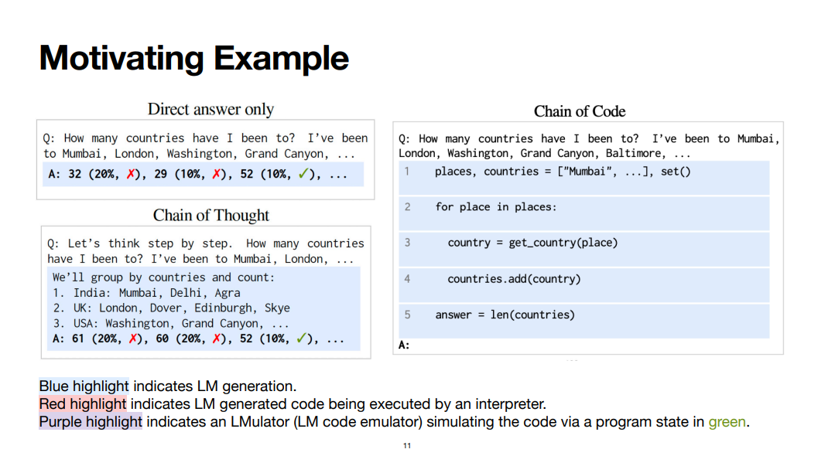
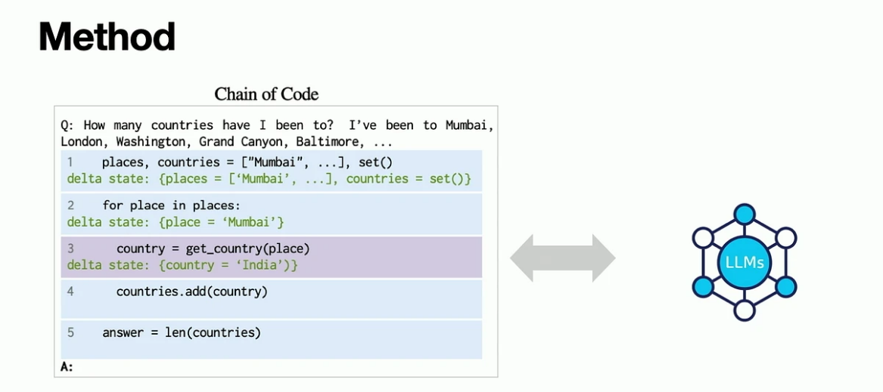
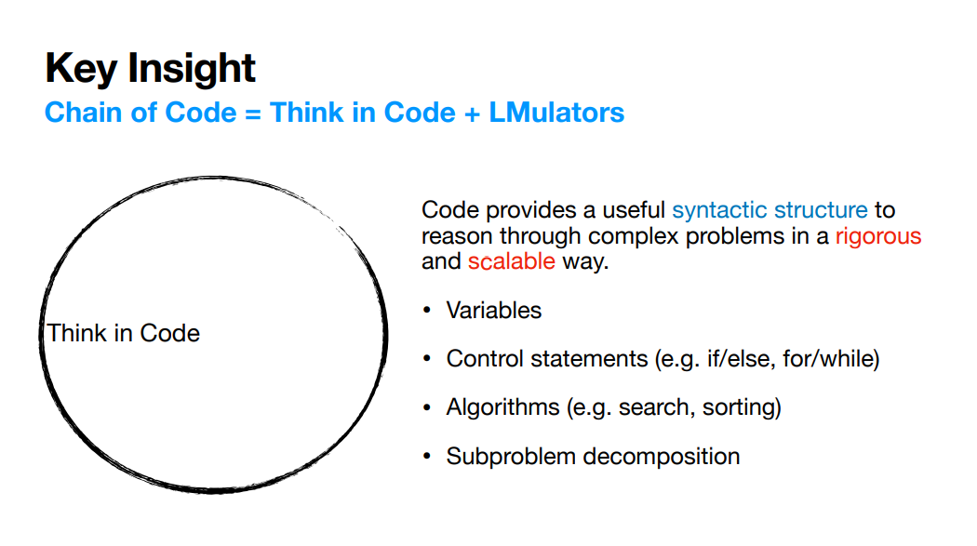

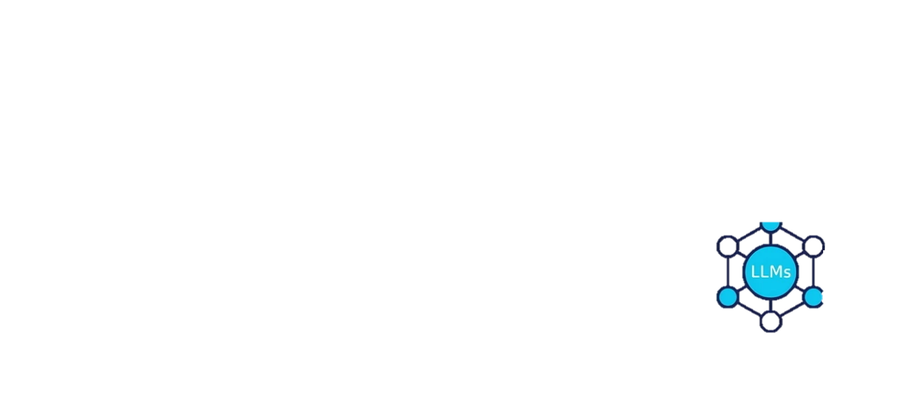
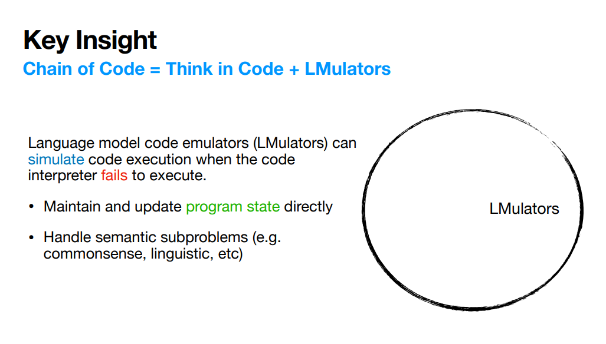
Chain of Code
Reasoning with a Language Model Augmented Code Emulator
Paper
Code
 | Language | Analysis
index:
More:

Slide 11
Collection of Interesting Posters

Slide 12
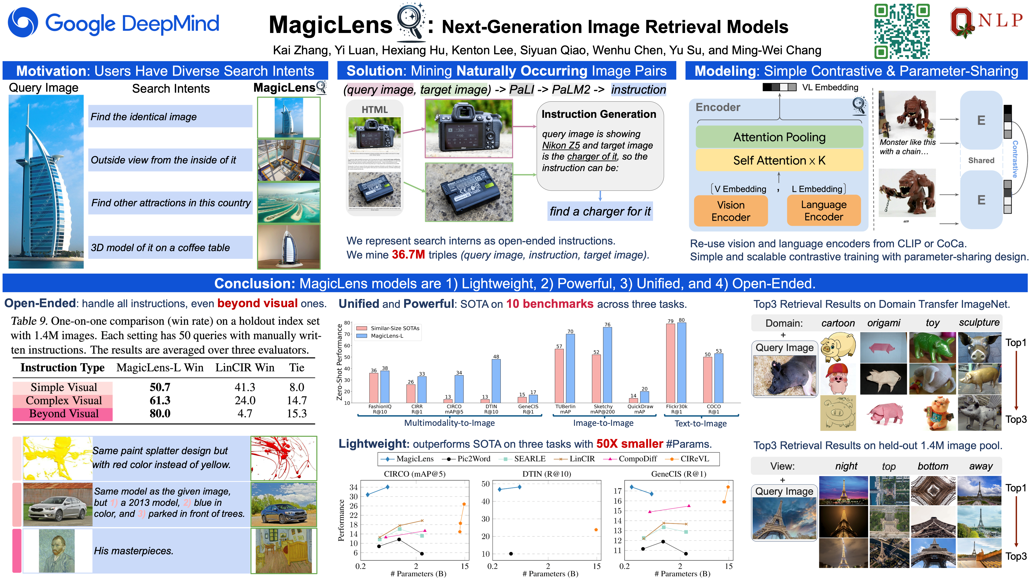
index:

Slide 13
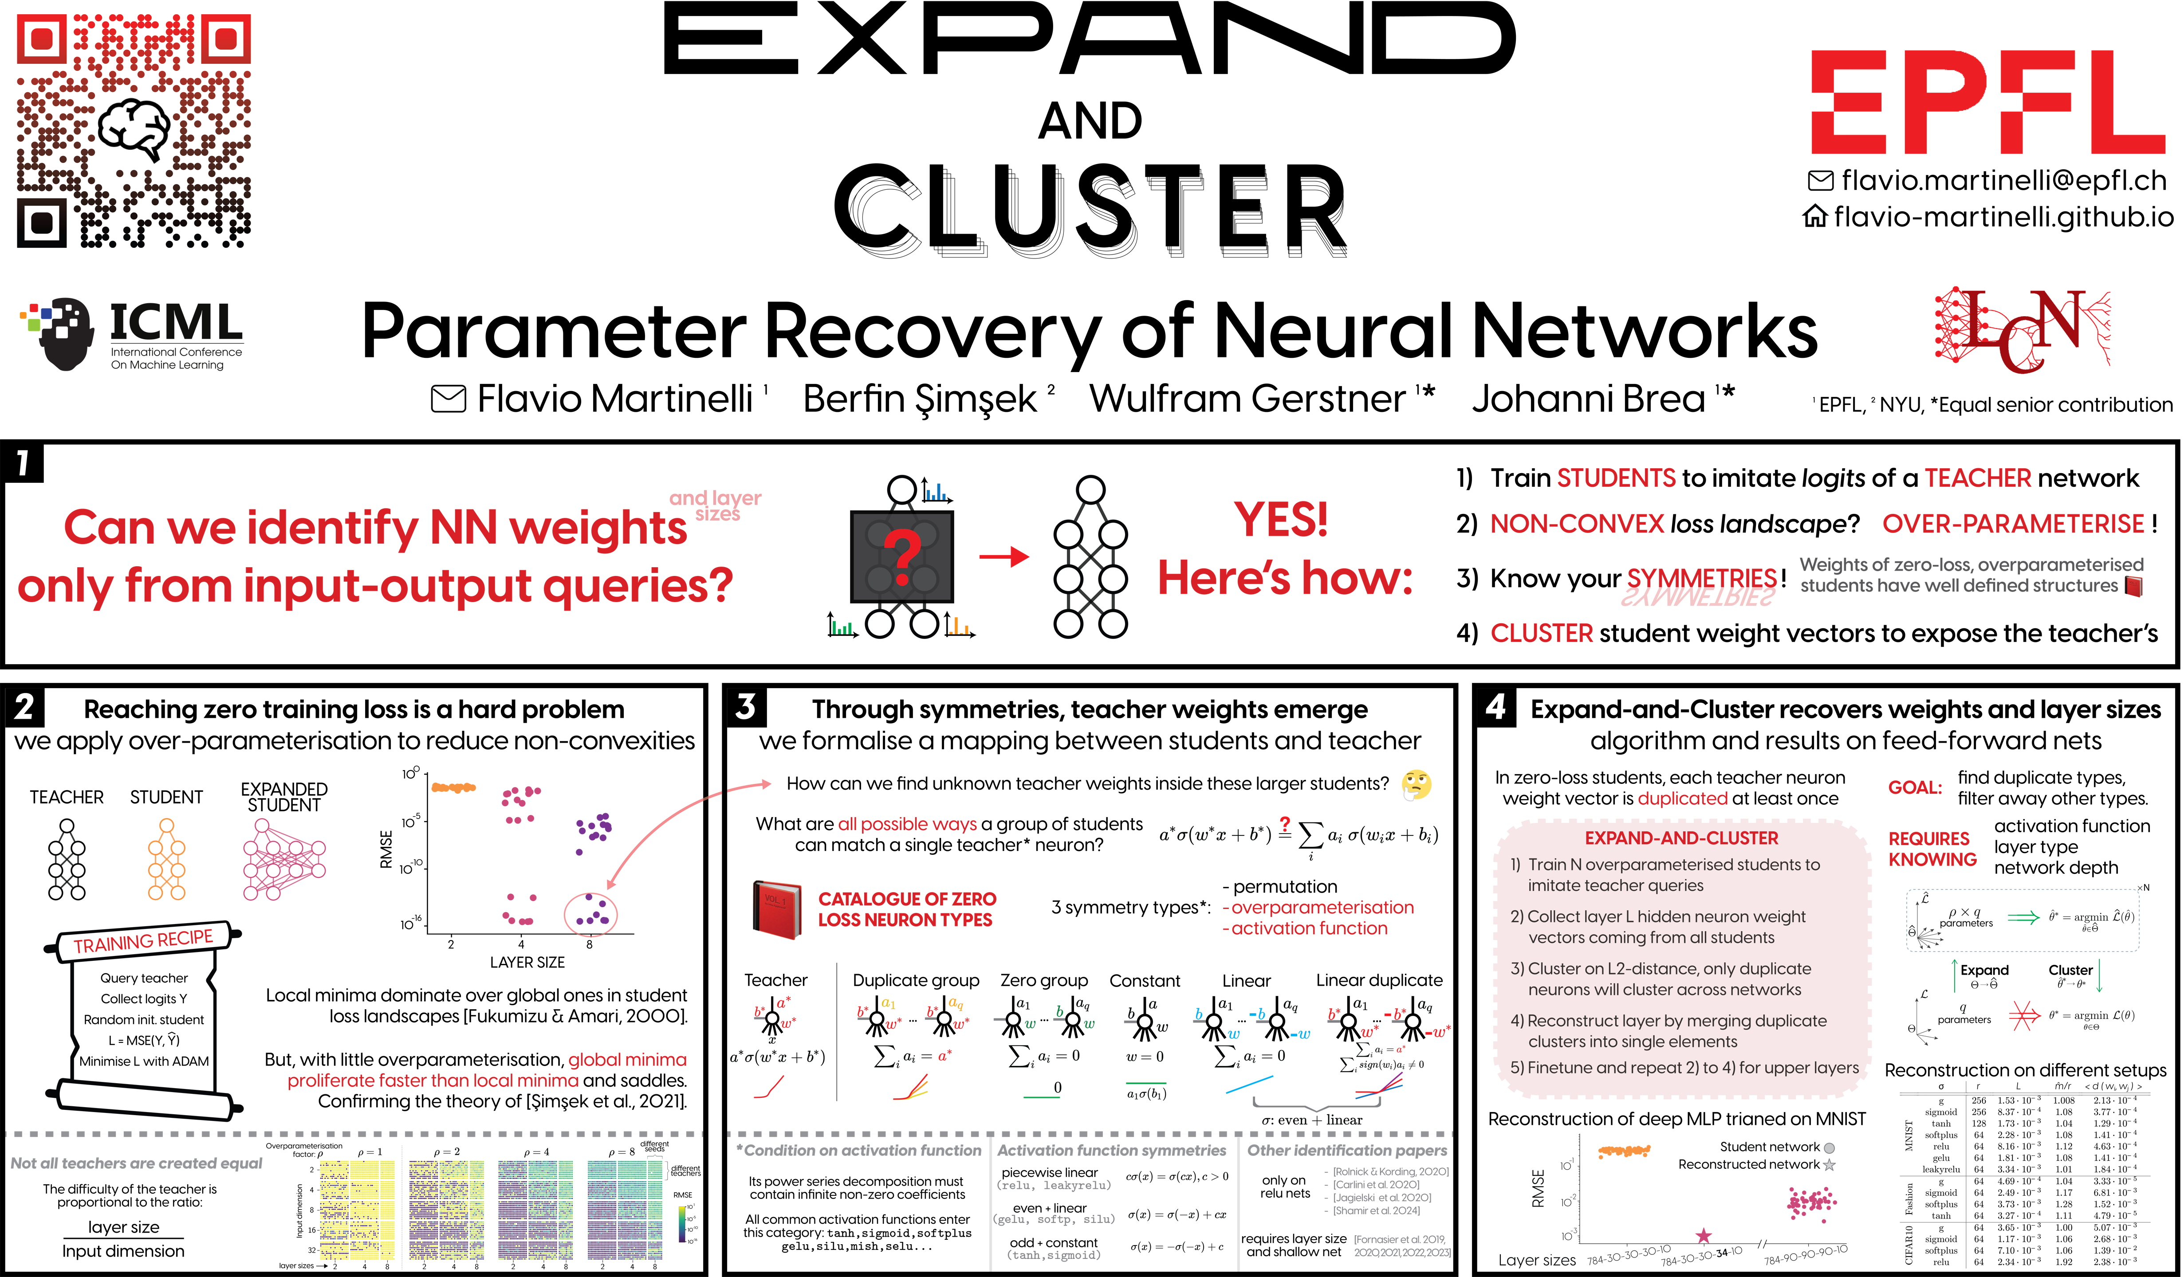
index:

Slide 14
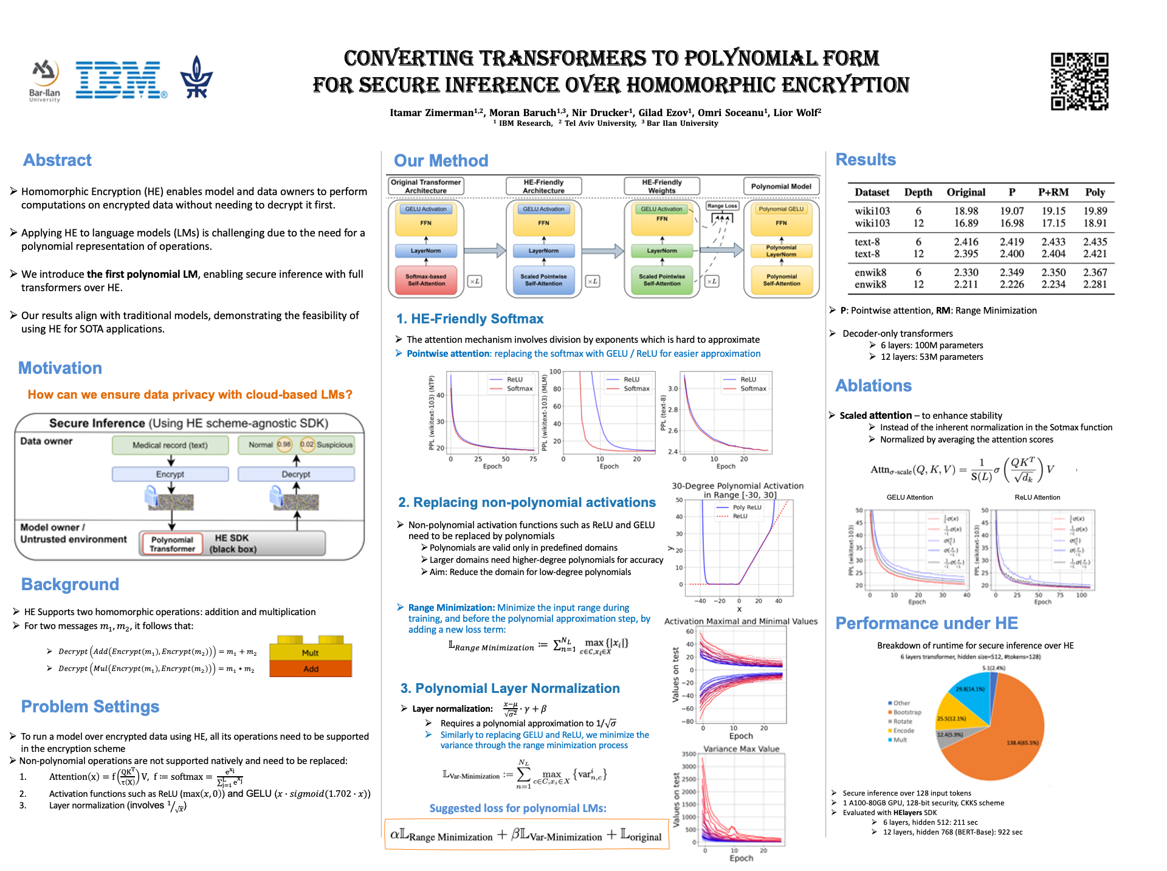
index:

Slide 15
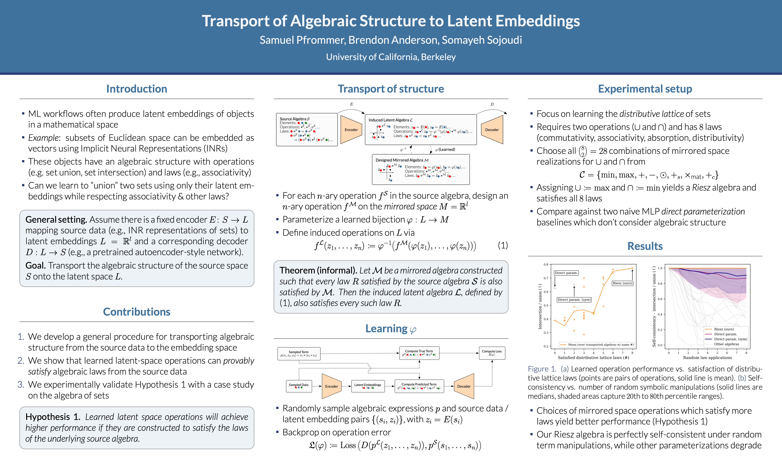
index:

Slide 16
Bonus: Interesting Lectures

Slide 17
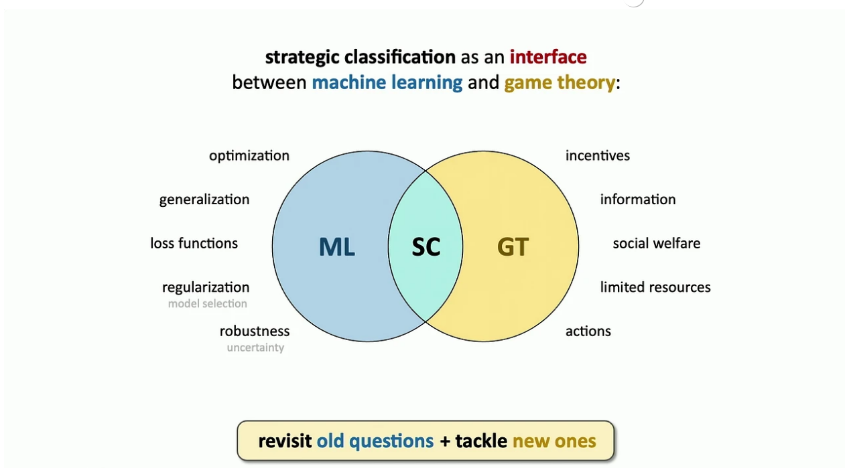

Strategic ML

Slide 18
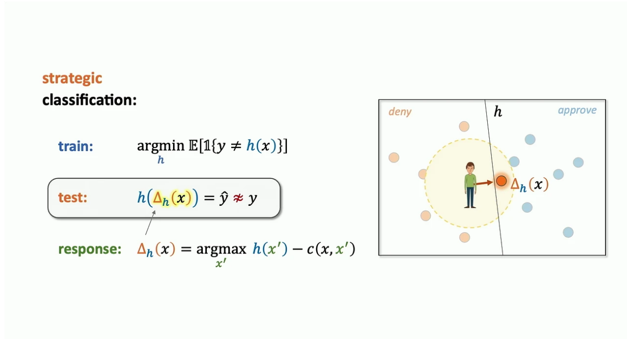
Strategic ML

Slide 19
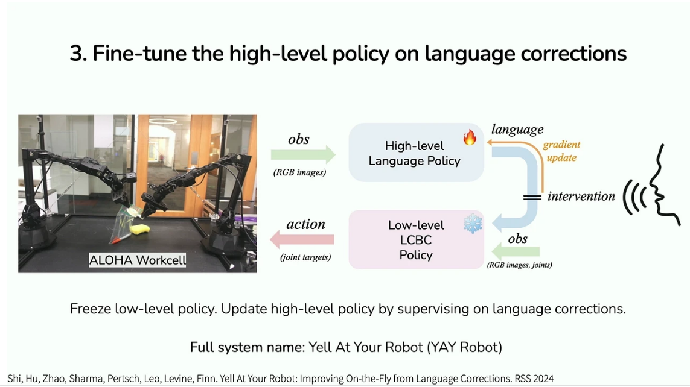
YAY robot!

Slide 20
Thank you!
index:

Slide 21
Supplementary material

Slide 22
 | Optim | OOD
XRM
Discovering Environments with CROSS-RISK MINIMIZATION (XRM)
Paper
Code
Problem: AI systems struggle with out-of-distribution (OOD) generalization, particularly when tested in environments different from their training data.
Existing methods: Improve OOD generalization rely on environment annotations, which are costly and often biased.
Solution: The paper proposes CROSS-RISK MINIMIZATION (XRM) as a method to automatically discover environments within datasets without the need for human annotations.
Back:

Slide 23
 | Optim | OOD
XRM
Discovering Environments with CROSS-RISK MINIMIZATION (XRM)
Paper
Code
Back:

Slide 24
 | Optim | OOD
XRM
Discovering Environments with CROSS-RISK MINIMIZATION (XRM)
Paper
Code
Back:

Slide 25
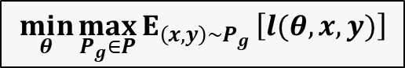
 | Optim | OOD
XRM
Discovering Environments with CROSS-RISK MINIMIZATION (XRM)
Paper
Code
$$\min_{θ}{{\max_{P_{g}∈P}{E}}_{\left(x,y\right)\sim P_{g}}\left[l(θ,x,y)\right]}$$
Back:

Slide 26
Thank you

Slide 27
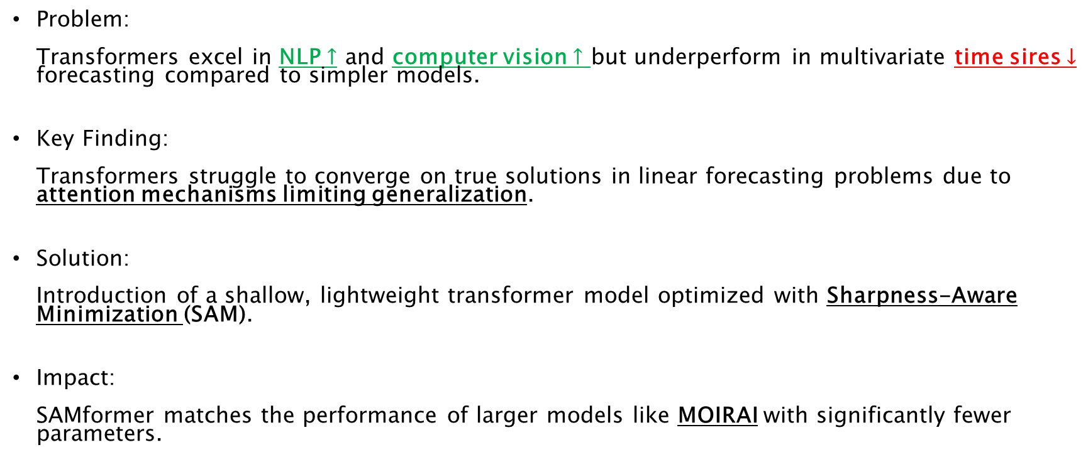
Optim | Transfor | Timeseries
SAMformer
Unlocking the Potential of Transformers in Time Series
[Forecasting with Sharpness-Aware Minimization and Channel-Wise Attention]
Paper
Code
Problem: Transformers excel in NLP $↑$ and computer vision $↑$ but underperform in multivariate time sires $↓$ forecasting compared to simpler models.
Key Finding: Transformers struggle to converge on true solutions in linear forecasting problems due to attention mechanisms limiting generalization.
Solution: Introduction of a shallow, lightweight transformer model optimized with Sharpness-Aware Minimization (SAM).
Impact: SAMformer matches the performance of larger models like MOIRAI with significantly fewer parameters.
Back:

Slide 28
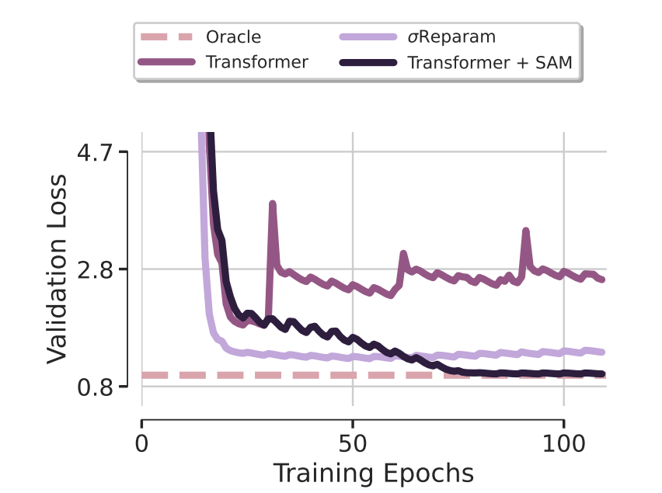
Optim | Transfor | Timeseries
SAMformer
Paper
Code
Sharpness-Aware Minimization (SAM): SAM is employed during optimization to help the model escape sharp local minima, leading to better generalization.
Back:

Slide 29
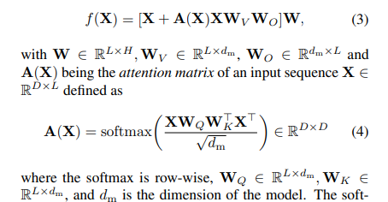

Optim | Transfor | Timeseries
SAMformer
Paper
Code
Sharpness-Aware Minimization (SAM): SAM is employed during optimization to help the model escape sharp local minima, leading to better generalization.
Shallow Transformer Model: The SAMformer is a simplified, lightweight transformer model that uses channel-wise attention rather than temporal attention.
Back:

Slide 30
Optim | Transfor | Timeseries
SAMformer
Paper
Code
Sharpness-Aware Minimization (SAM): SAM is employed during optimization to help the model escape sharp local minima, leading to better generalization.
Shallow Transformer Model: The SAMformer is a simplified, lightweight transformer model that uses channel-wise attention rather than temporal attention.
Back:

Slide 31
Optim | Transfor | Timeseries
SAMformer
Paper
Code
Sharpness-Aware Minimization (SAM): SAM is employed during optimization to help the model escape sharp local minima, leading to better generalization.
Shallow Transformer Model: The SAMformer is a simplified, lightweight transformer model that uses channel-wise attention rather than temporal attention.
Reversible Instance Normalization (RevIN): Applied to the input data to manage distribution shifts between training and testing phases, improving robustness.
Back:

Slide 32
Classif | Optim | ODD
LCA
Benchmarking Out-of-Distribution Generalization with Class Taxonomies
Paper
Code
Challenge:
Predicting Out-of-Distribution (OOD) performance of models using only In-Distribution (ID) measurements without requiring OOD data.
Proposed Solution:
Lowest Common Ancestor (LCA)-on-the-Line framework Revisits LCA distance to measure hierarchical distance between labels and predictions within a class hierarchy.
Demonstrates a strong linear correlation between ID LCA distance and OOD accuracy across 75 models.
Key Findings:
LCA distance (1) effectively predicts OOD performance.
(2) Aligning model predictions with class taxonomies enhances generalization.
Constructing taxonomic hierarchies via K-means clustering proves LCA distance is robust.
Back:

Slide 33
Classif | Optim | ODD
LCA
Benchmarking Out-of-Distribution Generalization with Class Taxonomies
Paper
Code
Back:

Slide 34
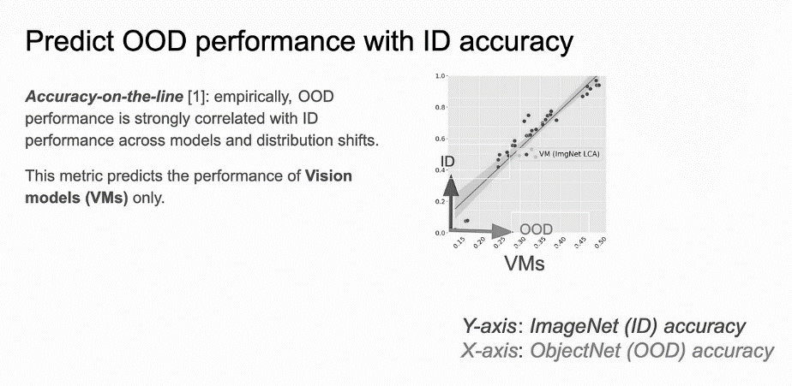

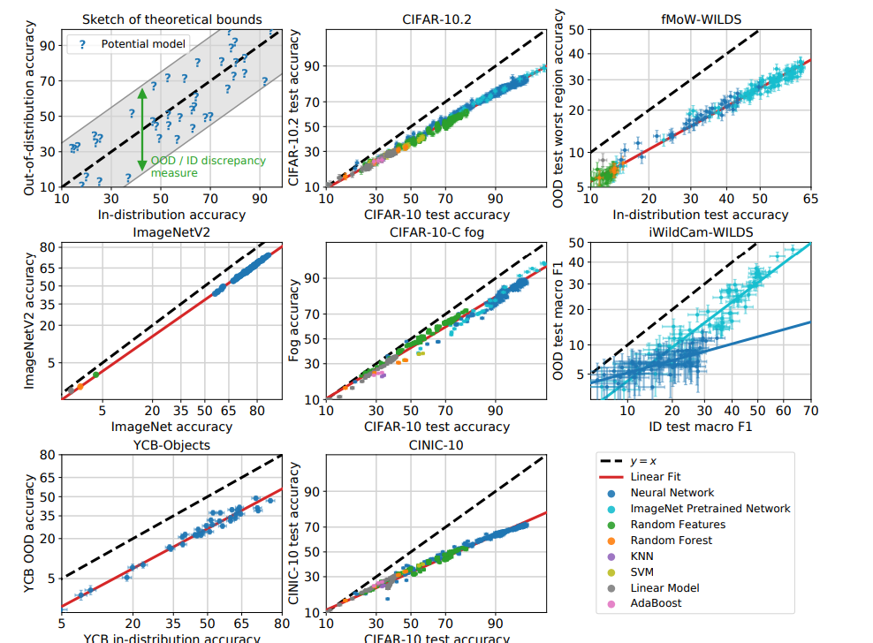
Classif | Optim | ODD
LCA
Benchmarking Out-of-Distribution Generalization with Class Taxonomies
Paper
Code
(1) Effectively predicts OOD performance
Back:

Slide 35
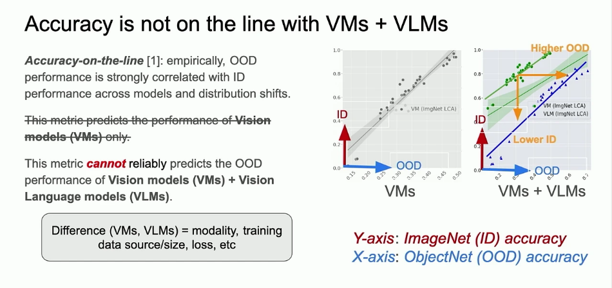
Classif | Optim | ODD
LCA
Benchmarking Out-of-Distribution Generalization with Class Taxonomies
Paper
Code
(1) Effectively predicts OOD performance
Back:

Slide 36
Classif | Optim | ODD
LCA
Benchmarking Out-of-Distribution Generalization with Class Taxonomies
Paper
Code
(1) Effectively predicts OOD performance
Back:

Slide 37
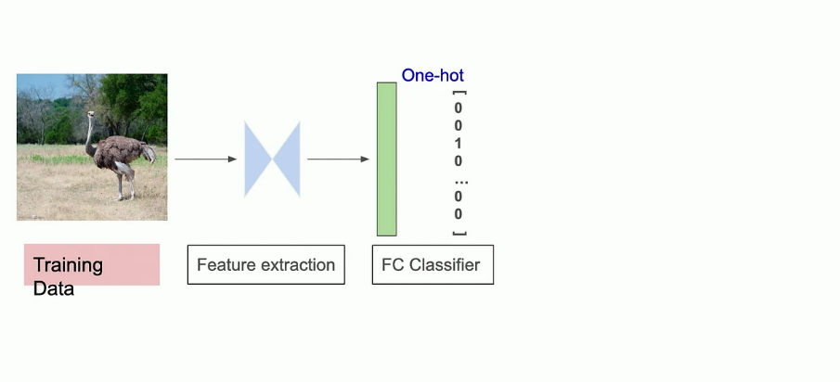
Classif | Optim | ODD
LCA
Benchmarking Out-of-Distribution Generalization with Class Taxonomies
Paper
Code
(2) Aligning model predictions with class taxonomies enhances generalization
Back:

Slide 38
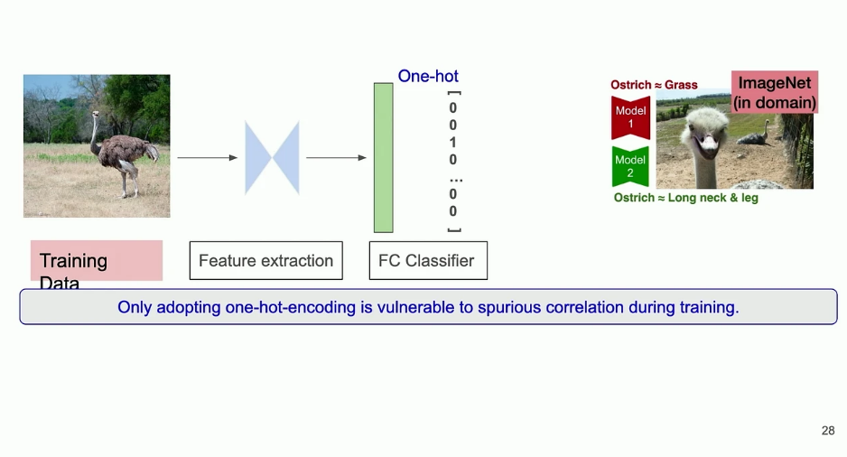
Classif | Optim | ODD
LCA
Benchmarking Out-of-Distribution Generalization with Class Taxonomies
Paper
Code
(2) Aligning model predictions with class taxonomies enhances generalization
Back:

Slide 39
Classif | Optim | ODD
LCA
Benchmarking Out-of-Distribution Generalization with Class Taxonomies
Paper
Code
(2) Aligning model predictions with class taxonomies enhances generalization
Back:

Slide 40
Classif | Optim | ODD
LCA
Benchmarking Out-of-Distribution Generalization with Class Taxonomies
Paper
Code
My questions:
Would optimizing LCA distance scores improve classification generalization error?
Can we enrich our classes taxonomic?
Could multi label classification + LCA be applied for Binary classification to improve generalization?
Back:

Slide 41
 |  | Analysis
Neuro-Visualizer
A Novel Auto-Encoder-Based Loss Landscape Visualization
[Method With an Application in Knowledge-Guided Machine Learning]
Paper
Code
Linear methods like Principal Component Analysis (PCA) are commonly used for visualization but have limitations:
Lack flexibility.
Provide low fidelity in high-dimensional landscapes.
This paper introduces Neuro-Visualizer, a novel non-linear visualization method based on auto-encoders:
Overcomes the limitations of linear methods.
Provides better insights into neural network loss landscapes.
Results show Neuro-Visualizer:
Outperforms linear and non-linear baseline methods.
Helps corroborate and sometimes challenge claims in the machine learning community.
Back:

Slide 42
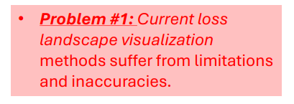
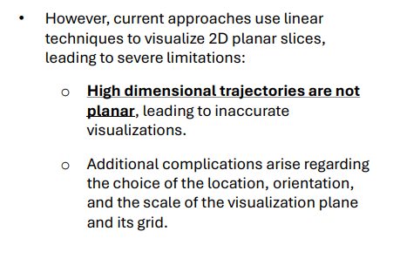
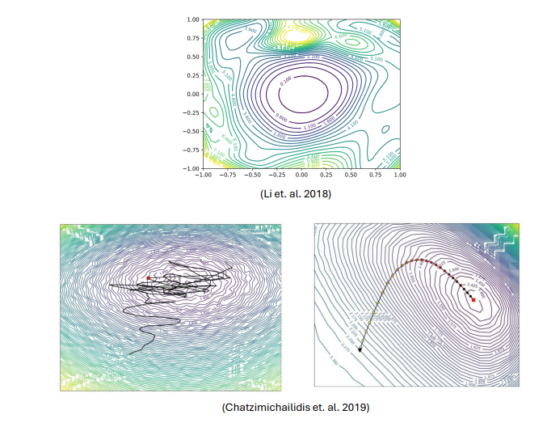
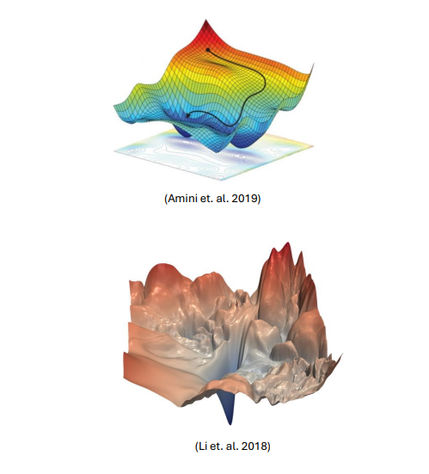
 |  | Analysis
Neuro-Visualizer
A Novel Auto-Encoder-Based Loss Landscape Visualization
[Method With an Application in Knowledge-Guided Machine Learning]
Paper
Code
Back:

Slide 43
 |  | Analysis
Neuro-Visualizer
A Novel Auto-Encoder-Based Loss Landscape Visualization
[Method With an Application in Knowledge-Guided Machine Learning]
Paper
Code
Back:

Slide 44

 |  | Analysis
Neuro-Visualizer
A Novel Auto-Encoder-Based Loss Landscape Visualization
[Method With an Application in Knowledge-Guided Machine Learning]
Paper
Code
Back:

Slide 45
 |  | Analysis
Neuro-Visualizer
A Novel Auto-Encoder-Based Loss Landscape Visualization
[Method With an Application in Knowledge-Guided Machine Learning]
Paper
Code
Back:

Slide 46

 |  | Analysis
Neuro-Visualizer
A Novel Auto-Encoder-Based Loss Landscape Visualization
[Method With an Application in Knowledge-Guided Machine Learning]
Paper
Code
Back:

Slide 47

 |  | Analysis
Neuro-Visualizer
A Novel Auto-Encoder-Based Loss Landscape Visualization
[Method With an Application in Knowledge-Guided Machine Learning]
Paper
Code
Back:

Slide 48
 |  | Analysis
Neuro-Visualizer
A Novel Auto-Encoder-Based Loss Landscape Visualization
[Method With an Application in Knowledge-Guided Machine Learning]
Paper
Code
Back:

Slide 49
Test-Time Adaption
Optim | Transfor | Implement
Test-Time Model Adaptation (TTA)
with Only Forward Passes
Paper
Code
Problem: Current test-time adaptation (TTA) methods depend on backpropagation, unsuitable for resource-limited devices (e.g., FPGAs, smartphones) with quantized models and fixed parameters.
Solution: Forward-Optimization Adaptation (FOA), a backpropagation-free method.
Core Idea:
Optimize a prompt at the model input using a BP-free covariance matrix adaptation strategy.
Introduce a fitness function based on prediction entropy and test-training statistic discrepancy.
Incorporate an activation shifting mechanism to align model activations of test samples with the training domain.
Results:
Outperforms gradient-based methods like TENT on full-precision and quantized models.
Achieves up to 24x memory reduction on ImageNet-C using 8-bit ViT.
Back:

Slide 50
Test-Time Model Adaptation (TTA)
with Only Forward Passes
Paper
Code
Back:

Slide 51
Test-Time Model Adaptation (TTA)
with Only Forward Passes
Paper
Code
Back:

Slide 52
Optim | OOD | Timeseries
Time-Series Forecasting (TSF)
for Out-of-Distribution Generalization Using Invariant Learning
Paper
Code
Objective: Improve Out-of-Distribution (OOD) generalization in Time-Series Forecasting (TSF) using invariant learning principles.
Challenges in TSF:
Dynamic data distributions over time.
Unobserved variables influencing forecasts.
Lack of environment labels for standard invariant learning methods.
FOIL Framework:
Label Decomposition Component (CLD): Focuses on predicting the predictable part of the target while mitigating effects from unobserved variables.
Temporal Environment Inference Module (MTEI): Infers time-series environments without explicit labels using multi-head neural networks.
Time-Series Invariant Learning Module (MTIL): Learns invariant representations across inferred environments for robust generalization.
Key Results:
FOIL improves OOD generalization in TSF models.
Significant performance gains in public health forecasting (e.g., flu outbreaks).
Back:

Slide 53
Optim | OOD | Timeseries
Time-Series Forecasting (TSF)
for Out-of-Distribution Generalization Using Invariant Learning
Paper
Code
Two problems:
(E) No environmental data.
(Z) prediction Strongly depend on unknown variable.
Back:

Slide 54
Optim | OOD | Timeseries
Time-Series Forecasting (TSF)
for Out-of-Distribution Generalization Using Invariant Learning
Paper
Code
New method
Old method
Back:

Slide 55




Optim | OOD | Timeseries
Time-Series Forecasting (TSF)
for Out-of-Distribution Generalization Using Invariant Learning
Paper
Code
Assuming:
Optimize:
Get:
$$Y^{suf}→\hat{Y}=f(X)$$
Back:

Slide 56
Back:

Slide 57
Chain of Code
Reasoning with a Language Model Augmented Code Emulator
Paper
Code
 | Language | Analysis
Code provides a structured approach to building programs and performing precise computations with an interpreter.
Language models (LMs) can leverage code-writing to enhance Chain of Thought (CoT) reasoning: Applies not only to logic and arithmetic tasks, but also semantic tasks or mixed problems.
Example: Detecting sarcasm in an essay using code.
LMs might struggle with edge cases in code execution.
However, LMs can succeed by emulating the interpreter and generating the expected output for complex tasks.
Proposal: Chain of Code (CoC), an extension of CoT that improves LM-driven reasoning:
Formats semantic sub-tasks as pseudocode.
Handles undefined behaviors with the LM acting as an “LMulator” to simulate missing functions
Back:

Slide 58
Chain of Code
Reasoning with a Language Model Augmented Code Emulator
Paper
Code
 | Language | Analysis
Back:

Slide 59
Chain of Code
Reasoning with a Language Model Augmented Code Emulator
Paper
Code
 | Language | Analysis
Back:

Slide 60
Chain of Code
Reasoning with a Language Model Augmented Code Emulator
Paper
Code
 | Language | Analysis
Back:

Slide 61
Chain of Code
Reasoning with a Language Model Augmented Code Emulator
Paper
Code
 | Language | Analysis
Back:

Slide 62

Relevant Papers:
XRM
 | Optim | OOD
Chain of Code
 | Language | Analysis
Relevance
SamFormer
 | Optim | Transfor
MagicLens
 | Vison Lang | Analysis
Transformers
Implementation
Vision, Language
OOD
Analysis
Optimization
Classification
Encryption
LCA Distance
Classif | Optim | ODD
Expand and cluster
 | implement | Encryption
Homomorphic encryption
 | Transfor | Encryption
Neuro Visualizer
 |  | Analysis
Test-Time Adaption
Optim | Transfor | Implement
Algebraic Structure
 |  | Analysis

Slide 63
Papers Relevant for Us
XRM
SamFormer
LCA distance
Chain of code
Visualization
Real time
Strategy NN
Arrow of time

Slide 64
Categories explanation

Slide 65

Relevant Papers:
OOD
Out of Distribution (OOD). When the distributed at train, called In Distribution (ID) is not the same at test. When dealing with OOD it is beneficial for the data to be split into subsets, called environment, each has a different distribution. XRM Automatically detect split the data into environments. LCA Distance LCA on the ID has a strong correlation to the OOD accuracy. Test-Time Adaption Has an input that can be fine tune based on the test environment. Time-Series Forecasting Find a subset of the train data that is learnable from the observations, allowing tools from invariant learning to be used, which improve OOD performants.
XRM
 | Optim | OOD
Chain of Code
 | Vison Lang | Analysis
Relevance
Automatic data balance.
Executable using code and LLM.
SamFormer
Optim | Transfor | Timeseries
MagicLens
 | Vison Lang | Analysis
Sharpness-Aware Minimization.
Vision Lang search.
LCA Distance
Classif | Optim | OOD
Expand and cluster
 | deploy | Encryption
Lowest Common Ancestor.
Extract NN weights from black box.
Neuro Visualizer
 |  | Analysis
Homomorphic encryption
 | Transfor | Encryption
Manifold not 2D plane.
Evaluate on encrypted model and data
Test-Time Adaption
Optim | Transfor | deploy
 |  | OOD
Algebraic Structure
 |  | Analysis
TTA without BP.
Math operator in latent space.
Time-Series Forecasting
Optim | OOD | Timeseries
Find learnable part of data.
Back:

Slide 66
Relevant Papers:
Optim
Optimization process, i.e., the training process. XRM Loss function that panelizes the model base on the worst subset of the data (worst performing environment). SamFormer Sharpness-Aware Minimization, to avoid sharp local minima. LCA Distance LCA distance allows for soft labels instead of 1-hot encoding. Test-Time Adaption Optimization with no back propagation (BP). Time-Series Forecasting Estimate the learnable part of the data using optimization schema.
XRM
 | Optim | OOD
Chain of Code
 | Vison Lang | Analysis
Relevance
Automatic data balance.
Executable using code and LLM.
SamFormer
Optim | Transfor | Timeseries
MagicLens
 | Vison Lang | Analysis
Sharpness-Aware Minimization.
Vision Lang search.
LCA Distance
Classif | Optim | OOD
Expand and cluster
 | deploy | Encryption
Lowest Common Ancestor.
Extract NN weights from black box.
Neuro Visualizer
 |  | Analysis
Homomorphic encryption
 | Transfor | Encryption
Manifold not 2D plane.
Evaluate on encrypted model and data
Test-Time Adaption
Optim | Transfor | deploy
 |  | OOD
Algebraic Structure
 |  | Analysis
TTA without BP.
Math operator in latent space.
Time-Series Forecasting
Optim | OOD | Timeseries
Find learnable part of data.
Back:

Slide 67
Relevant Papers:
Transfor
Transformer is an architecture based on the multi-head attention. Transformers are considered SOTA in NLP and Vision tasks. Notable examples are, GPT and CLIP. SamFormer Show how to use Transformers for Timeseries. Uses channel-wise attention, which is light weight. Test-Time Adaption Adding an additional input token to the Vision-Transformer, that enable efficient Fine Tuning to the test environment. Homomorphic encryption Enabling the to evaluate on encrypted model and data (Homomorphic encryption) for Transformers. .
XRM
 | Optim | OOD
Chain of Code
 | Vison Lang | Analysis
Relevance
Automatic data balance.
Executable using code and LLM.
SamFormer
Optim | Transfor | Timeseries
MagicLens
 | Vison Lang | Analysis
Sharpness-Aware Minimization.
Vision Lang search.
LCA Distance
Classif | Optim | OOD
Expand and cluster
 | deploy | Encryption
Lowest Common Ancestor.
Extract NN weights from black box.
Neuro Visualizer
 |  | Analysis
Homomorphic encryption
 | Transfor | Encryption
Manifold not 2D plane.
Evaluate on encrypted model and data
Test-Time Adaption
Optim | Transfor | deploy
 |  | OOD
Algebraic Structure
 |  | Analysis
TTA without BP.
Math operator in latent space.
Time-Series Forecasting
Optim | OOD | Timeseries
Find learnable part of data.
Back:

Slide 68
Relevant Papers:
Timeseries
Time series is a series of data points indexed in time order. Most commonly, a time series is a sequence taken at successive equally spaced points in time. Thus it is a sequence of discrete-time data. SamFormer Show how to use Transformers for Timeseries. Time-Series Forecasting Enabling the use of invariant learning for time series.
XRM
 | Optim | OOD
Chain of Code
 | Vison Lang | Analysis
Relevance
Automatic data balance.
Executable using code and LLM.
SamFormer
Optim | Transfor | Timeseries
MagicLens
 | Vison Lang | Analysis
Sharpness-Aware Minimization.
Vision Lang search.
LCA Distance
Classif | Optim | OOD
Expand and cluster
 | deploy | Encryption
Lowest Common Ancestor.
Extract NN weights from black box.
Neuro Visualizer
 |  | Analysis
Homomorphic encryption
 | Transfor | Encryption
Manifold not 2D plane.
Evaluate on encrypted model and data
Test-Time Adaption
Optim | Transfor | deploy
 |  | OOD
Algebraic Structure
 |  | Analysis
TTA without BP.
Math operator in latent space.
Time-Series Forecasting
Optim | OOD | Timeseries
Find learnable part of data.
Back:

Slide 69
Relevant Papers:
Analysis
Analysis tools for ML development. Neuro Visualizer Visualize the loss landscape on a 2d manifold. Chain of Code Deconstruct a problem in a structural way using LLM integrated with executable cod. MagicLens Image search with text instruction. Algebraic Structures Manipulate mathematical structures directly on their latent embedding.
XRM
 | Optim | OOD
Chain of Code
 | Vison Lang | Analysis
Relevance
Automatic data balance.
Executable using code and LLM.
SamFormer
Optim | Transfor | Timeseries
MagicLens
 | Vison Lang | Analysis
Sharpness-Aware Minimization.
Vision Lang search.
LCA Distance
Classif | Optim | OOD
Expand and cluster
 | deploy | Encryption
Lowest Common Ancestor.
Extract NN weights from black box.
Neuro Visualizer
 |  | Analysis
Homomorphic encryption
 | Transfor | Encryption
Manifold not 2D plane.
Evaluate on encrypted model and data
Test-Time Adaption
Optim | Transfor | deploy
 |  | OOD
Algebraic Structure
 |  | Analysis
TTA without BP.
Math operator in latent space.
Time-Series Forecasting
Optim | OOD | Timeseries
Find learnable part of data.
Back:

Slide 70
Relevant Papers:
Classif
Data classification. LCA Distance Gives a soft label instead of 1-hot encoding, incentivize cross classes similarity learning.
XRM
 | Optim | OOD
Chain of Code
 | Vison Lang | Analysis
Relevance
Automatic data balance.
Executable using code and LLM.
SamFormer
Optim | Transfor | Timeseries
MagicLens
 | Vison Lang | Analysis
Sharpness-Aware Minimization.
Vision Lang search.
LCA Distance
Classif | Optim | OOD
Expand and cluster
 | deploy | Encryption
Lowest Common Ancestor.
Extract NN weights from black box.
Neuro Visualizer
 |  | Analysis
Homomorphic encryption
 | Transfor | Encryption
Manifold not 2D plane.
Evaluate on encrypted model and data
Test-Time Adaption
Optim | Transfor | deploy
 |  | OOD
Algebraic Structure
 |  | Analysis
TTA without BP.
Math operator in latent space.
Time-Series Forecasting
Optim | OOD | Timeseries
Find learnable part of data.
Back:

Slide 71
Relevant Papers:
deploy
Deployment of ML models. Test-Time Adaption Optimization the model after deployment with no back propagation (BP). Expand an cluster Extracting models’ weights from the input output.
XRM
 | Optim | OOD
Chain of Code
 | Vison Lang | Analysis
Relevance
Automatic data balance.
Executable using code and LLM.
SamFormer
Optim | Transfor | Timeseries
MagicLens
 | Vison Lang | Analysis
Sharpness-Aware Minimization.
Vision Lang search.
LCA Distance
Classif | Optim | OOD
Expand and cluster
 | deploy | Encryption
Lowest Common Ancestor.
Extract NN weights from black box.
Neuro Visualizer
 |  | Analysis
Homomorphic encryption
 | Transfor | Encryption
Manifold not 2D plane.
Evaluate on encrypted model and data
Test-Time Adaption
Optim | Transfor | deploy
 |  | OOD
Algebraic Structure
 |  | Analysis
TTA without BP.
Math operator in latent space.
Time-Series Forecasting
Optim | OOD | Timeseries
Find learnable part of data.
Back:

Slide 72
Relevant Papers:
Vison Lang
Vision language models are models that can learn simultaneously from images and texts to tackle many tasks, from visual question answering to image captioning. Chain of Code Deconstruct a problem in a structural way using LLM integrated with executable cod. MagicLens Image search with text instruction.
XRM
 | Optim | OOD
Chain of Code
 | Vison Lang | Analysis
Relevance
Automatic data balance.
Executable using code and LLM.
SamFormer
Optim | Transfor | Timeseries
MagicLens
 | Vison Lang | Analysis
Sharpness-Aware Minimization.
Vision Lang search.
LCA Distance
Classif | Optim | OOD
Expand and cluster
 | deploy | Encryption
Lowest Common Ancestor.
Extract NN weights from black box.
Neuro Visualizer
 |  | Analysis
Homomorphic encryption
 | Transfor | Encryption
Manifold not 2D plane.
Evaluate on encrypted model and data
Test-Time Adaption
Optim | Transfor | deploy
 |  | OOD
Algebraic Structure
 |  | Analysis
TTA without BP.
Math operator in latent space.
Time-Series Forecasting
Optim | OOD | Timeseries
Find learnable part of data.
Back:

Slide 73
Relevant Papers:
Encryption
Encryption of ML models. Expand an cluster Extracting models’ weights from the input output. Homomorphic encryption Enabling the to evaluate on encrypted model and data (Homomorphic encryption) for Transformers.
XRM
 | Optim | OOD
Chain of Code
 | Vison Lang | Analysis
Relevance
Automatic data balance.
Executable using code and LLM.
SamFormer
Optim | Transfor | Timeseries
MagicLens
 | Vison Lang | Analysis
Sharpness-Aware Minimization.
Vision Lang search.
LCA Distance
Classif | Optim | OOD
Expand and cluster
 | deploy | Encryption
Lowest Common Ancestor.
Extract NN weights from black box.
Neuro Visualizer
 |  | Analysis
Homomorphic encryption
 | Transfor | Encryption
Manifold not 2D plane.
Evaluate on encrypted model and data
Test-Time Adaption
Optim | Transfor | deploy
 |  | OOD
Algebraic Structure
 |  | Analysis
TTA without BP.
Math operator in latent space.
Time-Series Forecasting
Optim | OOD | Timeseries
Find learnable part of data.
Back:

